Slide 1
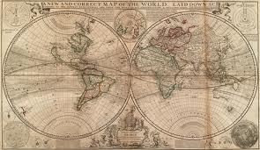
AIM: To evaluate the use of indices to measure disparities

Slide 2
In your groups of 4
Discuss
Which indices are better than others?
Are some easier to collate than others?
Notes:
5 mins and feedback

Slide 3
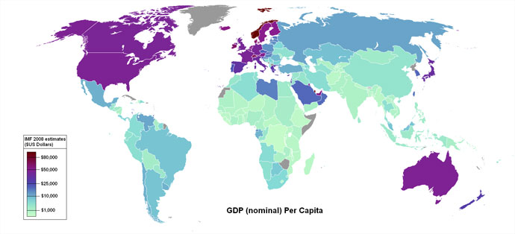
World GDP Map
Gross domestic product (GDP) is a basic measurement of the economic performance and national income of a country. Gross national product (GNP) is very similar to GDP, the only difference is that GDP defines its results based on geographical location whereas GNP's results are based upon ownership.

Slide 4
Positives | Negatives
GDP data is usually reliable, accurate and an easily accessible. Relatively simple to identify which countries are more economically developed than others. | Has some anomalies, such as Saudi Arabia with a small population of extremely rich people, this balances out the GDP. Doesn't show the distribution of wealth within countries, so doesn't reflect the true level of development.

Slide 5
Equity: the concept of idea of fairness or justice.
Social justice: the belief that every individual and group is entitled to fair and equal rights and participation in social, educational, and economic opportunities.
Marginalisation: relegate to a lower or outer edge, as of specific groups of people.
Interdependence: the mutual responsibility and dependency on others.

Slide 6
Evaluation
Indicator | Strength | Weakness
Infant mortality
Literacy rate
Education expenditure
Malnutrition prevalence
GNI
HDI
Brandt Line
Other measure
Notes:
15 mins

Slide 7
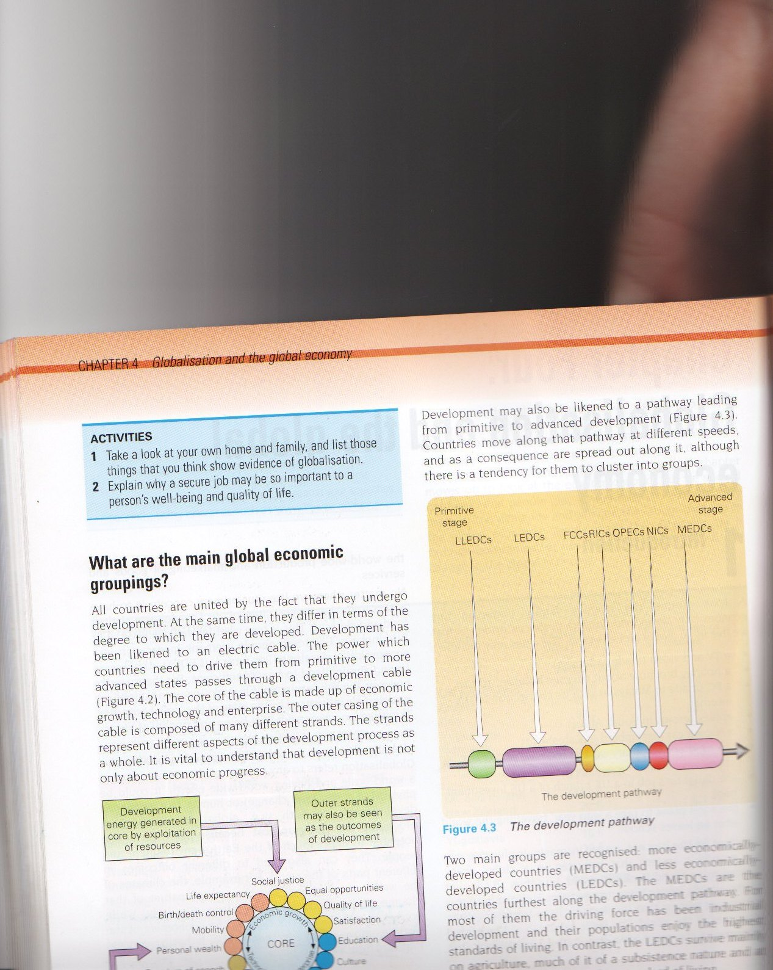
Views on Development
The Development Pathway
Development can also be seen as a pathway.
Countries develop at different speeds and may cluster at different places
What could hinder development?

Slide 8
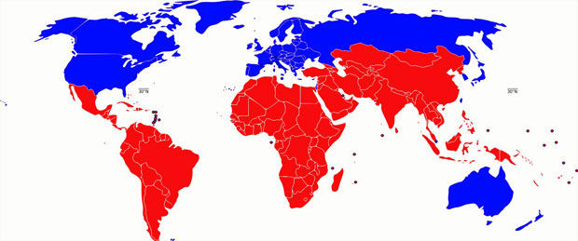
Brandt Line

Slide 9
Positives | Negatives
Simplifies data so that it's easy to understand. GDP is used which is an easy to access data source. | Doesn't include some countries which are more economically developed. Generalised patterns with some countries above the Brandt line less developed less than some below.

Slide 10
HDI ranks
Which countries will be the top 3?
Which countries will be the bottom 3?

Slide 11
Choose 6 countries
These must include some that we have looked at so far in the core
You could choose; China, Brazil, DR Congo, Indonesia, Kenya, Norway, USA
Identify their HDI ranking
Explain why they are where they are
Suggest ways in which they could improve their ranking.
Describe the trends in their HDI over time

Slide 12
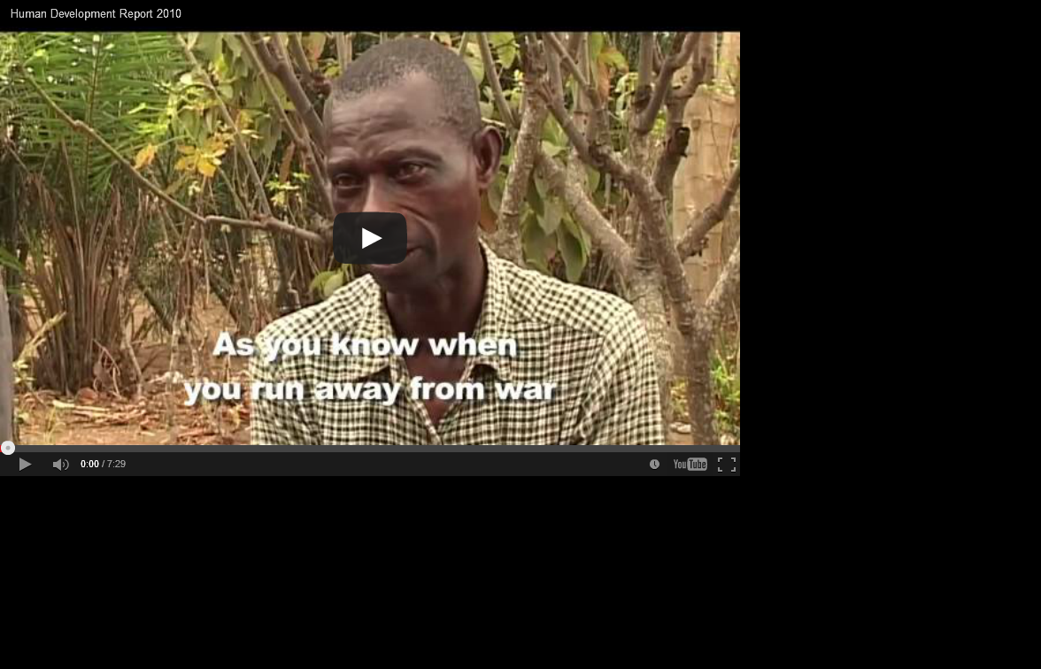
Why is HDI a useful measurement?
http://www.youtube.com/watch?v=xIbkPPkuKno&feature=player_embedded

Slide 13
Other criteria
2) Social, cultural and welfare criteria
Human Development Index (HDI) gives a country a score between 0 and 1 and is based on life expectancy, education and income.
Enables anomalies to be spotted and identifies where poverty is greatest
X No measure of human rights or freedom. Is a separate Human Freedom Index in 1991 but has not been done since.
Birth rates
Death rate
Infant mortality rate
Lack of clean water
% rural population
Types of employment
Level of literacy

Slide 14
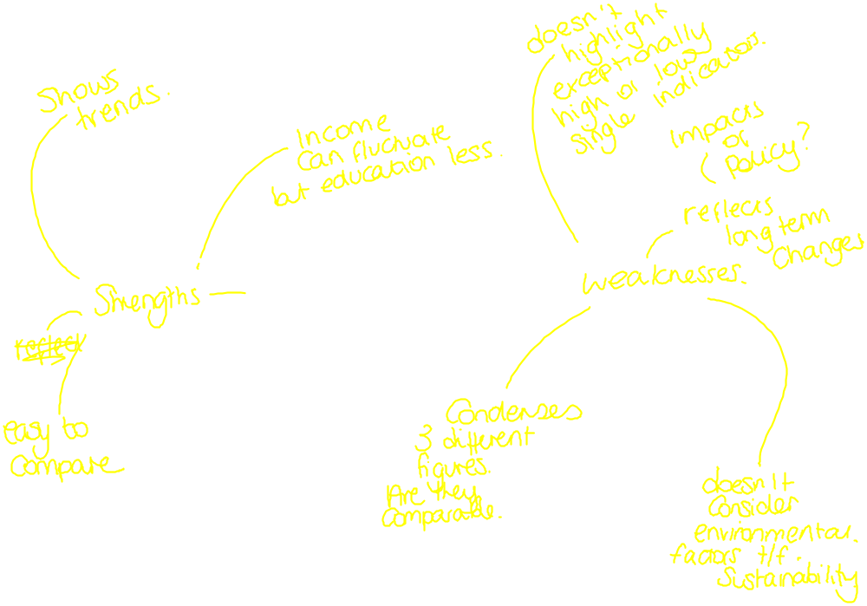

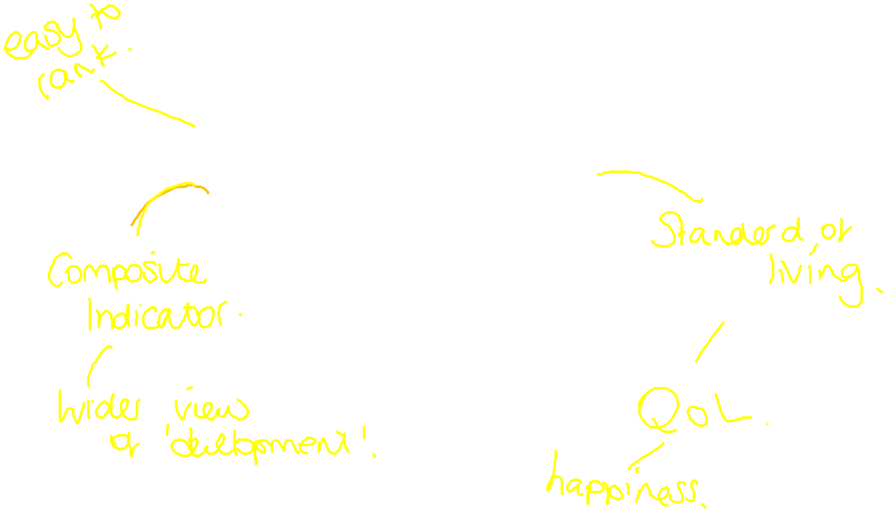
What are the strengths and weaknesses of HDI to measure development?

Slide 15
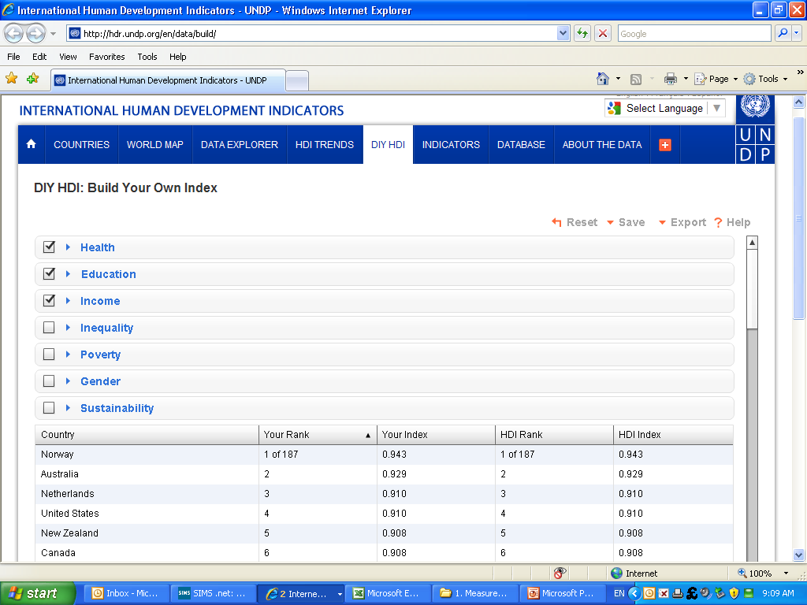
http://hdr.undp.org/en/data/build/

Slide 16
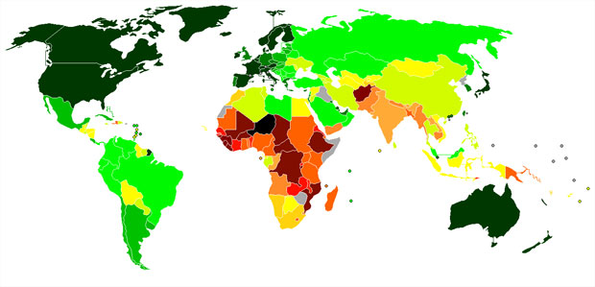
World HDI Map

Slide 17
Positives | Negatives
Shows more detail than the Brandt line with more data for each individual country. Relatively simple to identify which countries are more developed than others. | Doesn't show the distribution of wealth within countries. This doesn't reflect the true level of development, for example Brazil with a different standard of living between the Amazon rainforest and the Golden Triangle (Rio DE Janiero, Sao Paolo, Belo Horizonte).

Slide 18

Qualitative measures of development….
http://www.youtube.com/watch?v=7Zqdqa4YNvI&feature=related

Slide 19
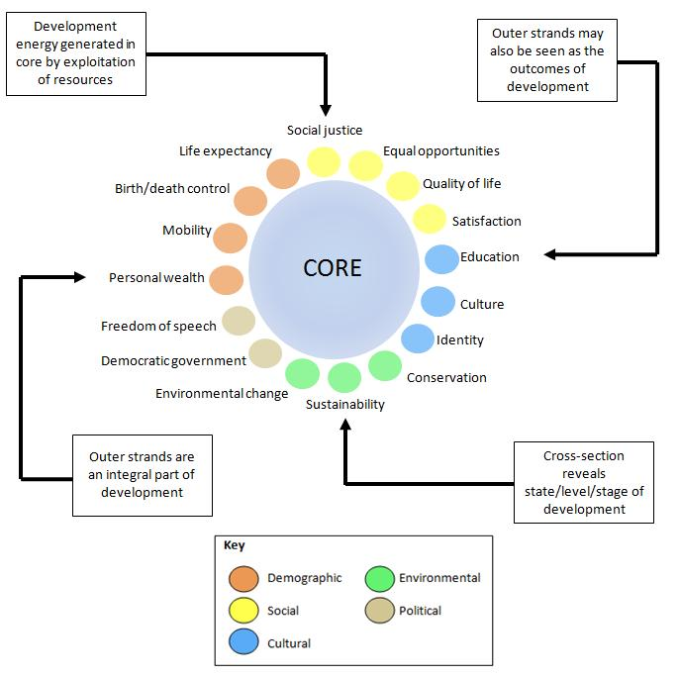

Slide 20

What’s so good about being developed?
Where in the world would you be happiest?

Slide 21
Index of Marginalisation p89
What is it?
What does it include?
Describe the patterns of marginalization in Mexico
http://www.geographyalltheway.com/in/ib-patterns-change/imagesetc/index-marginalization.pdf

Slide 22
Other indices of development from the course companion
Which do you think is the most useful

